Slide 1
Standard Algorithmic Analysis Techniques

Slide 2
Instructor
Dr. Ab Rouf Khan
Assistant Professor
VIT Bhopal University

Slide 3
Entry level Questions
Order of Growth of Functions Classification
Does size matter in analyzing algorithms for time complexity?
How to analyze loops and statements for the time complexity?

Slide 4
Performance Classification
f(n) | Classification
1 | Constant: run time is fixed, and does not depend upon n. Most instructions are executed once, or only a few times, regardless of the amount of information being processed
log n | Logarithmic: when n increases, so does run time, but much slower. Common in programs which solve large problems by transforming them into smaller problems. Exp : binary Search
n | Linear: run time varies directly with n. Typically, a small amount of processing is done on each element. Exp: Linear Search
n log n | When n doubles, run time slightly more than doubles. Common in programs which break a problem down into smaller sub-problems, solves them independently, then combines solutions. Exp: Merge
n² | Quadratic: when n doubles, runtime increases fourfold. Practical only for small problems; typically the program processes all pairs of input (e.g. in a double nested loop). Exp: Insertion Search
n³ | Cubic: when n doubles, runtime increases eightfold. Exp: Matrix
2^{n} | Exponential: when n doubles, run time squares. This is often the result of a natural, “brute force” solution. Exp: Brute Force. Note: logn, n, nlogn, n²>> less Input>>Polynomial n^{3,} 2^{n}>>high input>> non polynomial

Slide 5
Size Does Matter [1]
What happens if we double the input size N?
N log₂N 5N N log₂N N² 2^{N}
8 3 40 24 64 256
16 4 80 64 256 65536
32 5 160 160 1024 ~10⁹
64 6 320 384 4096 ~10¹⁹
128 7 640 896 16384 ~10³⁸
256 8 1280 2048 65536 ~10⁷⁶

Slide 6
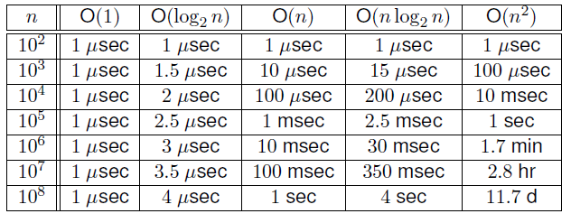
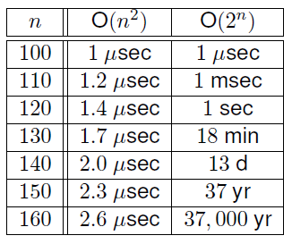
Size does matter[2]
Size Does Matter [2] [A better example!]

Slide 7
Size does matter[2]
Size Does Matter [3]
Suppose a program has run time O(n!) and the run time for n = 10 is 1 second
For n = 12, the run time is 2 minutes
For n = 14, the run time is 6 hours
For n = 16, the run time is 2 months
For n = 18, the run time is 50 years
For n = 20, the run time is 200 centuries

Slide 8
Standard Analysis Techniques
Constant time statements
Analyzing Loops
Analyzing Nested Loops
Analyzing Sequence of Statements
Analyzing Conditional Statements

Slide 9
Constant time statements
Simplest case: O(1) time statements
Assignment statements of simple data types int x = y;
Arithmetic operations: x = 5 * y + 4 - z;
Array referencing: A[j] = 5;
Array assignment: ∀ j, A[j] = 5;
Most conditional tests: if (x < 12) ...

Slide 10
Analyzing Loops [1] (In terms of Growth of Functions)
// Input: int A[N], array of N integers
// Output: Sum of all numbers in array A
int Sum(int A[], int N){
int s=0;
for (int i=0; i< N; i++)
s = s + A[i];
return s;
}
1
2
3
4
1,2,8: Once
3,4,5,6,7: Once per each iteration
of for loop, N iteration
Total: 5N + 3
The complexity function of the
algorithm is : f(N) = 5N +3
5
6
7
8

Slide 11
Analyzing Loops [2]
Any loop has two parts:
How many iterations are performed?
How many steps per iteration?
int sum = 0,j;
for (j=0; j < n; j++)
sum = sum +j;
Loop executes n times (0…n-1)
4 = O(1) steps per iteration
Total time is n* O(1) = O(n*1) = O(n)

Slide 12
Analyzing Loops [3]
What about this for loop?
int sum =0, j;
for (j=0; j < 100; j++)
sum = sum +j;
Loop executes 100 times
4 = O(1) steps per iteration
Total time is 100 * O(1) = O(100 * 1) = O(100) = O(1)

Slide 13
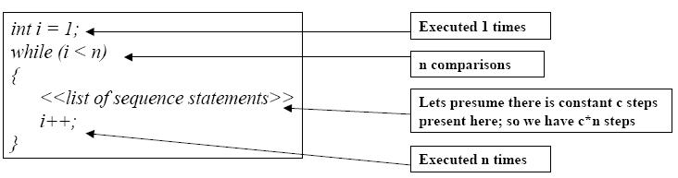
Analyzing Loops [Linear Loops]
What about this while loop?
Efficiency is proportional to the number of iterations.
Efficiency time function is :
f(n) = 1 + (n-1) + c*(n-1) +( n-1)
= (c+2)*(n-1) + 1
= (c+2)n – (c+2) +1
Asymptotically, efficiency is : O(n)

Slide 14
Analyzing Nested Loops [1]
Treat just like a single loop and evaluate each level of nesting as needed:
int j,k;
for (j=0; j<N; j++)
for (k=N; k>0; k--)
sum += k+j;
Start with outer loop:
How many iterations? N
How much time per iteration? Need to evaluate inner loop
Inner loop uses O(N) time
Total time is N * O(N) = O(N*N) = O(N²)

Slide 15
Analyzing Nested Loops [2]
What if the number of iterations of one loop depends on the counter of the other?
int j,k;
for (j=0; j < N; j++)
for (k=0; k < j; k++)
sum += k+j;
Analyze inner and outer loop together:
Number of iterations of the inner loop is:
0 + 1 + 2 + ... + (N-1) = O(N²) [How? Activity 1]

Slide 16
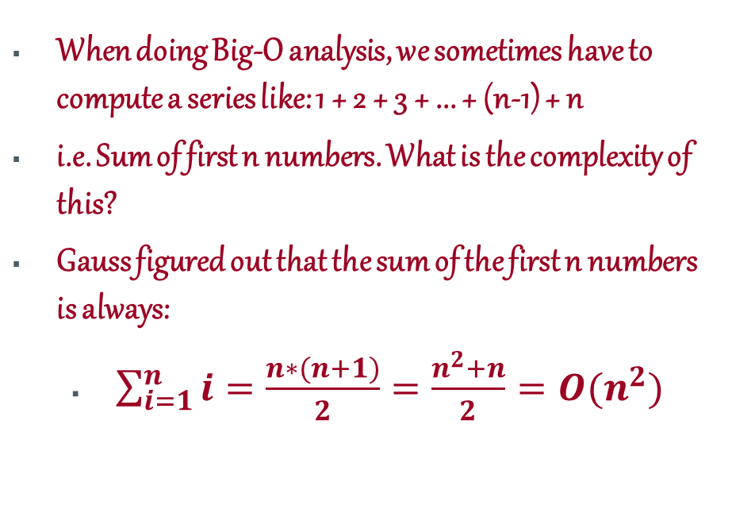
Solution [Activity 1]
When doing Big-O analysis, we sometimes have to compute a series like: 1 + 2 + 3 + ... + (n-1) + n
i.e. Sum of first n numbers. What is the complexity of this?
Gauss figured out that the sum of the first n numbers is always:
$\sum_{i=1}^{n}{i=\frac{n∗(n+1)}{2}=\frac{n^{2}+n}{2}}=O(n^{2})$

Slide 17

Sequence of Statements
For a sequence of statements, compute their complexity functions individually and add them up.
Total cost is O($N^{2}$) + O(N) +O(1) = O($N^{2}$)

Slide 18
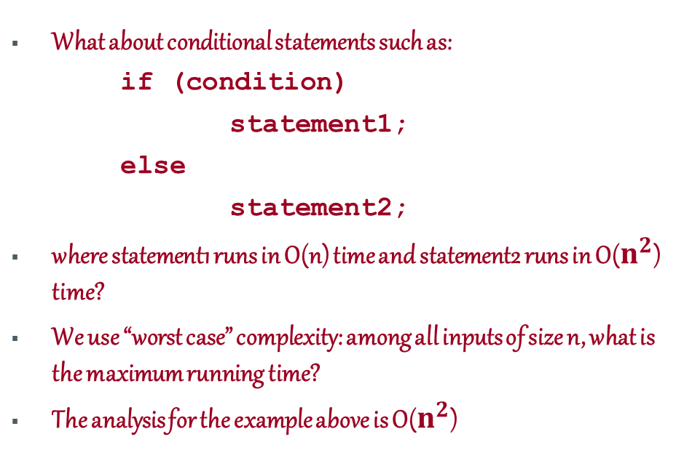
Conditional Statements
What about conditional statements such as:
if (condition)
statement1;
else
statement2;
where statement1 runs in O(n) time and statement2 runs in O($n^{2}$) time?
We use “worst case” complexity: among all inputs of size n, what is the maximum running time?
The analysis for the example above is O($n^{2}$)

Slide 19
A Real Life Example
Carry n items from one room to another room
How many operations?
n pick-ups, n forward moves, n drops and n reverse moves -> 4 n operations
4n operations = c. n = O(c. n) = O(n)
Similarly, any program that reads n inputs from the user will have minimum time complexity O(n).

Slide 20

Recap

Slide 21
Thank You

